Slide 1

Exploratory data analysis

Slide 2
Content:
Introduction To EDA
Why EDA
Goals Of EDA
Understanding Of EDA

Slide 3
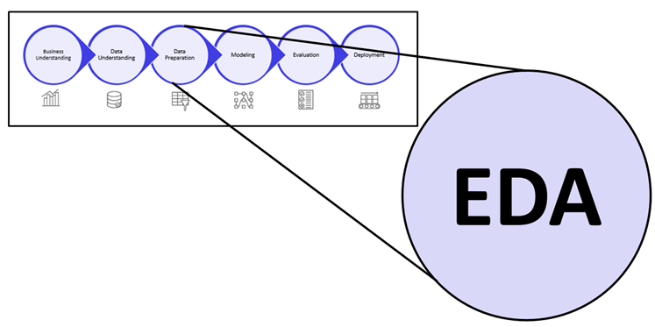
Introduction to eda
Exploratory Data Analysis, or EDA, is an important step in any Data Analysis or Data Science project.
EDA is the process of investigating the dataset to discover patterns, and anomalies (outliers), and form hypotheses based on our understanding of the dataset.
EDA involves generating summary statistics for numerical data in the dataset and creating various graphical representations to understand the data better

Slide 4
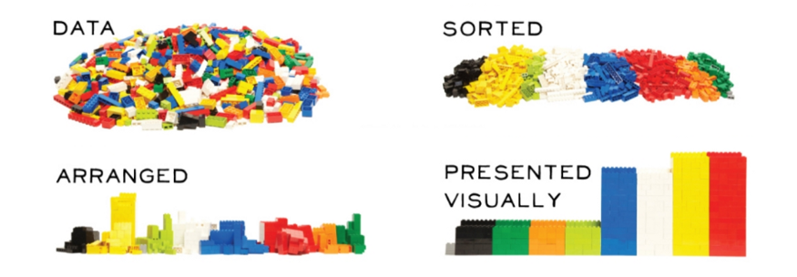
Torture the data, it will confess to anything

Slide 5
Why EDA ?
Get a better understanding of dataset and helps cleanup the given dataset
Understanding data patterns
Drawing graphs and charts for better understanding
Providing guidelines for essential variables and leaving behind/removing non-essential variables
For checking the quality of data for further processing and data cleaning
Identifying Outliers
This process would be maximizing insights of a dataset

Slide 6

Goals of EDA
Primary goal of EDA is to maximize the analyst’s insight into a data set and into the underlying structure of a data set, by providing all of the specific items that an analyst would want to extract from a data set, such as:
a good-fitting, parsimonious model
a list of outliers
a sense of robustness of conclusions
estimates for parameters
uncertainties for those estimates
a ranked list of important factors
conclusions as to whether individual factors are statistically significant

Slide 7
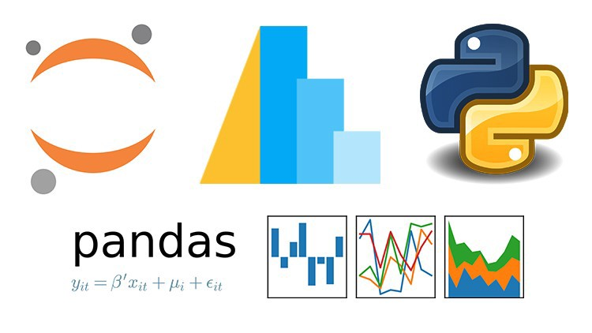
Understanding EDA

Slide 8


Slide 9
Exploratory Data Analysis (EDA) – A step by step guide
Importing libraries
We will start by importing the libraries we will require for performing EDA.
First, we will import all the python libraries that are required for this, which include NumPy for numerical calculations and scientific computing, Pandas for handling data, and Matplotlib and Seaborn for visualization.
import pandas as pd import numpy as np import matplotlib import matplotlib.pyplot as plt import seaborn as sns %matplotlib inline

Slide 10

Reading Data
We will now read the data from a CSV file into a Pandas DataFrame. The data-set can be downloaded from here.
Loading the data into the pandas data frame is certainly one of the most important steps in EDA, as we can see that the value from the data set is comma-separated. So all we have to do is to just read the CSV into a data frame and pandas data frame does the job for us
df = pd.read_csv("data.csv")

Slide 11
We can check if the data is successfully imported by displaying the first 5 rows of important columns of my dataset dataframe.
df_Columns = pd.read_csv("data.csv", usecols = ['Make','Model','Year','Engine Fuel Type','Engine HP','Transmission Type','MSRP’])
df_Columns.head(5)
 | Make | Model | Year | Engine Fuel Type | Engine HP | Transmission Type | MSRP
0 | BMW | 1 Series M | 2011 | premium unleaded (required) | 335.0 | MANUAL | 46135
1 | BMW | 1 Series | 2011 | premium unleaded (required) | 300.0 | MANUAL | 40650
2 | BMW | 1 Series | 2011 | premium unleaded (required) | 300.0 | MANUAL | 36350
3 | BMW | 1 Series | 2011 | premium unleaded (required) | 230.0 | MANUAL | 29450
4 | BMW | 1 Series | 2011 | premium unleaded (required) | 230.0 | MANUAL | 34500

Slide 12
TO get the total information of our dataset
df.info()
<class 'pandas.core.frame.DataFrame'>
RangeIndex: 11914 entries, 0 to 11913
Data columns (total 16 columns):
# Column Non-Null Count Dtype
--- ------ -------------- -----
0 Make 11914 non-null object
1 Model 11914 non-null object
2 Year 11914 non-null int64
3 Engine Fuel Type 11911 non-null object
4 Engine HP 11845 non-null float64
5 Engine Cylinders 11884 non-null float64
6 Transmission Type 11914 non-null object
7 Driven_Wheels 11914 non-null object
8 Number of Doors 11908 non-null float64
9 Market Category 8172 non-null object
10 Vehicle Size 11914 non-null object
11 Vehicle Style 11914 non-null object
12 highway MPG 11914 non-null int64
13 city mpg 11914 non-null int64
14 Popularity 11914 non-null int64
15 MSRP 11914 non-null int64
dtypes: float64(3), int64(5), object(8)
memory usage: 1.5+ MB

Slide 13
To get the statistics of our dataset
The describe() method computes and displays summary statistics for a python dataframe.
(It also operates on data frame columns and pandas series objects.)
So, if you have a data frame or a Series object, you can use the describe method and it will output statistics like:
mean
median
standard deviation
minimum
maximum
percentiles
Etc..
So, we get the summary statistics of our dataframe using the below syntax:
df.describe(include='all')

Slide 14
Statistics
 | Make | Model | Year | Engine Fuel Type | Engine HP | Engine Cylinders | Transmission Type | Driven_Wheels | Number of Doors | Market Category | Vehicle Size | Vehicle Style | highway MPG | city mpg | Popularity | MSRP
count | 11914 | 11914 | 11914.000000 | 11911 | 11845.00000 | 11884.000000 | 11914 | 11914 | 11908.000000 | 8172 | 11914 | 11914 | 11914.000000 | 11914.000000 | 11914.000000 | 1.191400e+04
unique | 48 | 915 | NaN | 10 | NaN | NaN | 5 | 4 | NaN | 71 | 3 | 16 | NaN | NaN | NaN | NaN
top | Chevrolet | Silverado 1500 | NaN | regular unleaded | NaN | NaN | AUTOMATIC | front wheel drive | NaN | Crossover | Compact | Sedan | NaN | NaN | NaN | NaN
freq | 1123 | 156 | NaN | 7172 | NaN | NaN | 8266 | 4787 | NaN | 1110 | 4764 | 3048 | NaN | NaN | NaN | NaN
mean | NaN | NaN | 2010.384338 | NaN | 249.38607 | 5.628829 | NaN | NaN | 3.436093 | NaN | NaN | NaN | 26.637485 | 19.733255 | 1554.911197 | 4.059474e+04
std | NaN | NaN | 7.579740 | NaN | 109.19187 | 1.780559 | NaN | NaN | 0.881315 | NaN | NaN | NaN | 8.863001 | 8.987798 | 1441.855347 | 6.010910e+04
min | NaN | NaN | 1990.000000 | NaN | 55.00000 | 0.000000 | NaN | NaN | 2.000000 | NaN | NaN | NaN | 12.000000 | 7.000000 | 2.000000 | 2.000000e+03
25% | NaN | NaN | 2007.000000 | NaN | 170.00000 | 4.000000 | NaN | NaN | 2.000000 | NaN | NaN | NaN | 22.000000 | 16.000000 | 549.000000 | 2.100000e+04
50% | NaN | NaN | 2015.000000 | NaN | 227.00000 | 6.000000 | NaN | NaN | 4.000000 | NaN | NaN | NaN | 26.000000 | 18.000000 | 1385.000000 | 2.999500e+04
75% | NaN | NaN | 2016.000000 | NaN | 300.00000 | 6.000000 | NaN | NaN | 4.000000 | NaN | NaN | NaN | 30.000000 | 22.000000 | 2009.000000 | 4.223125e+04
max | NaN | NaN | 2017.000000 | NaN | 1001.00000 | 16.000000 | NaN | NaN | 4.000000 | NaN | NaN | NaN | 354.000000 | 137.000000 | 5657.000000 | 2.065902e+06

Slide 15

Checking the DataTypes
We usually check for the datatypes because sometimes the columns would be stored as a string or object, If in that case, we have to convert that string to the integer data to plot the data via a graph.
df.dtypes

Slide 16

In our dataset,
We can change the column type with the astype method. Let's apply this method to the MSRP feature to convert string into int64:
df["MSRP "] = df["MSRP "].astype("int64")

Slide 17
Dropping irrelevant columns
In Our Dataset, there are many columns that we never use where dropping is the only solution. In this case, the columns such as Engine Fuel Type, Market Category, Vehicle style, Popularity, Number of doors, Vehicle Size doesn't make any sense to me So I will be dropping these columns in my data analysis.
df.drop(['Engine Fuel Type', 'Market Category', 'Vehicle Style', 'Popularity', 'Number of Doors', 'Vehicle Size'], axis=1)

Slide 18
Renaming the columns
In this instance, most of the column names are very confusing to read, so I just tweaked their column names. This is a good approach it improves the readability of the data set.
df.rename(columns={"Engine HP": "HP", "Engine Cylinders": "Cylinders", "Transmission Type": "Transmission", "Driven_Wheels": "Drive Mode","highway MPG": "MPG-H", "city mpg": "MPG-C", "MSRP": "Price" })

Slide 19
Dropping the duplicate rows
Our huge dataset contains more than 10, 000 rows which will often have some duplicate data which might be disturbing, so here I remove all the duplicate value from the data-set.
For example, prior to removing I had 11914 rows of data but after removing the duplicates 10925 data meaning that I had 989 of duplicate data.
df.count() #Counting the number of rows
Make 11914
Model 11914
Year 11914
HP 11845
Cylinders 11884
Transmission 11914
Drive Mode 11914
MPG-H 11914
MPG-C 11914
Price 11914
dtype: int64

Slide 20
Dropping the duplicate rows
So seen above there are 11914 rows and we are removing 989 rows of duplicate data.
df.drop_duplicates()
df.count()
Make 10925
Model 10925
Year 10925
HP 10856
Cylinders 10895
Transmission 10925
Drive Mode 10925
MPG-H 10925
MPG-C 10925
Price 10925
dtype: int64

Slide 21
Dropping the missing or null values
This is mostly similar to the previous step but in here all the missing values are detected and are dropped later. Now, this is not a good approach to do so, because many people just replace the missing values with the mean or the average of that column, but in this case, I just dropped that missing values. This is because there is nearly 100 missing value compared to 10, 000 values this is a small number and this is negligible so I just dropped those values.
df = df.dropna() # Dropping the missing values.
df.isnull().sum()
Make 0
Model 0
Year 0
HP 0
Cylinders 0
Transmission 0
Drive Mode 0
MPG-H 0
MPG-C 0
Price 0
dtype: int64

Slide 22
CounTING Of Unique values
value_counts() function returns object containing counts of unique values.
df['Price'].value_counts()
2000 599
29995 18
25995 16
20995 15
27995 15
...
49795 1
51525 1
47740 1
25199 1
2027 1
Name: Price, Length: 6014, dtype: int64

Slide 23
Normalizing the values of attirbutes
df["Price"].value_counts(normalize=True)
2000 0.055325
29995 0.001663
25995 0.001478
20995 0.001385
27995 0.001385
...
49795 0.000092
51525 0.000092
47740 0.000092
25199 0.000092
2027 0.000092
Name: Price, Length: 6014, dtype: float64

Slide 24
Sorting values in descending order
df.sort_values(by="Make", ascending=False).head()
 | Make | Model | Year | HP | Cylinders | Transmission | Drive Mode | MPG-H | MPG-C | Price
8119 | Volvo | S90 | 2017 | 250.0 | 4.0 | AUTOMATIC | front wheel drive | 34 | 23 | 46950
10085 | Volvo | V60 | 2016 | 240.0 | 4.0 | AUTOMATIC | front wheel drive | 29 | 25 | 41750
10554 | Volvo | XC90 | 2017 | 316.0 | 4.0 | AUTOMATIC | all wheel drive | 25 | 20 | 55600
10555 | Volvo | XC | 2002 | 197.0 | 5.0 | AUTOMATIC | all wheel drive | 23 | 17 | 36500
10090 | Volvo | V60 | 2017 | 302.0 | 4.0 | AUTOMATIC | all wheel drive | 31 | 23 | 48950

Slide 25
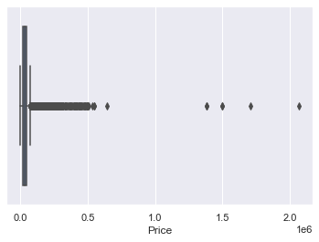
Detecting Outliers
An outlier is a point or set of points that are different from other points. Sometimes they can be very high or very low. It's often a good idea to detect and remove the outliers. Because outliers are one of the primary reasons for resulting in a less accurate model. Hence it's a good idea to remove them. The outlier detection and removing that I am going to perform is called IQR score technique. Often outliers can be seen with visualizations using a box plot. Shown below are the box plot of MSRP, Cylinders, Horsepower and EngineSize. Herein all the plots, you can find some points are outside the box they are none other than outliers
sns.boxplot(x=df['Price’])

Slide 26
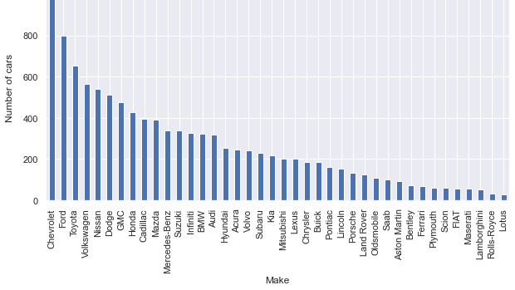
Plot different features against one another (scatter), against frequency (histogram)
Histogram refers to the frequency of occurrence of variables in an interval. In this case, there are mainly 10 different types of car manufacturing companies, but it is often important to know who has the most number of cars. To do this histogram is one of the trivial solutions which lets us know the total number of car manufactured by a different company.
df.Make.value_counts().nlargest(40).plot(kind='bar', figsize=(10,5))
plt.title("Number of cars by make")
plt.ylabel('Number of cars’)
plt.xlabel('Make');

Slide 27
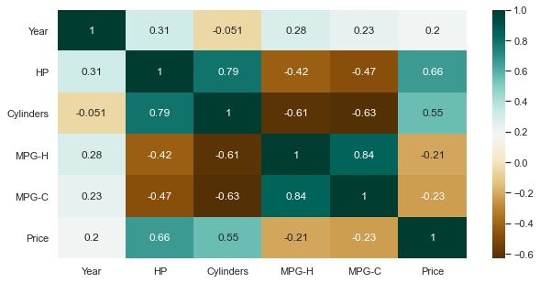
Heat Maps
Heat Maps is a type of plot which is necessary when we need to find the dependent variables. One of the best way to find the relationship between the features can be done using heat maps. In the below heat map we know that the price feature depends mainly on the Engine Size, Horsepower, and Cylinders.
plt.figure(figsize=(10,5))
c= df.corr()
sns.heatmap(c,cmap="BrBG",annot=True)

Slide 28
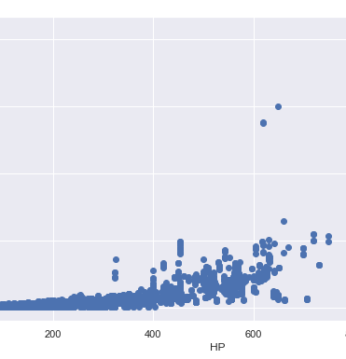
Scatterplot
We generally use scatter plots to find the correlation between two variables. Here the scatter plots are plotted between Horsepower and Price and we can see the plot below. With the plot given below, we can easily draw a trend line. These features provide a good scattering of points.
fig, ax = plt.subplots(figsize=(10,6))
ax.scatter(df['HP'], df['Price’])
ax.set_xlabel('HP’)
ax.set_ylabel('Price’)
plt.show()

Slide 29
References
https://www.aismartz.com/blog/why-eda-is-crucial-for-any-data-science-project/
https://www.ibm.com/cloud/learn/exploratory-data-analysis
https://towardsdatascience.com/exploratory-data-analysis-in-python-c9a77dfa39ce
https://www.datacamp.com/community/tutorials/kaggle-machine-learning-eda
https://towardsdatascience.com/exploratory-data-analysis-8fc1cb20fd15
https://www.analyticsvidhya.com/blog/2021/04/rapid-fire-eda-process-using-python-for-ml-implementation/
https://slideplayer.com/slide/12349351/
https://www.slideshare.net/DavisDavid2/exploratory-data-analysis-with-python
https://www.powershow.com/viewht/d124b-ZDc1Z/Exploratory_Data_Analysis_powerpoint_ppt_presentation
https://www.coursehero.com/file/49991031/EXPLORATORY-DATA-ANALYSISppt/
https://www.itl.nist.gov/div898/handbook/eda/section1/eda14.htm
https://www.analyticsvidhya.com/blog/2021/02/introduction-to-exploratory-data-analysis-eda/
https://www.analyticsvidhya.com/blog/2021/05/exploratory-data-analysis-eda-a-step-by-step-guide/
https://www.analyticsvidhya.com/blog/2021/05/exploratory-data-analysis-eda-a-step-by-step-guide/
https://towardsdatascience.com/exploratory-data-analysis-eda-a-practical-guide-and-template-for-structured-data-abfbf3ee3bd9
https://r4ds.had.co.nz/exploratory-data-analysis.html
https://medium.com/code-heroku/introduction-to-exploratory-data-analysis-eda-c0257f888676

Slide 30



Slide 31

By
Anusha Arjun Ganesh
Yogesh Prabhakar
Lakshmi Sudha Aluru

